Slide 1
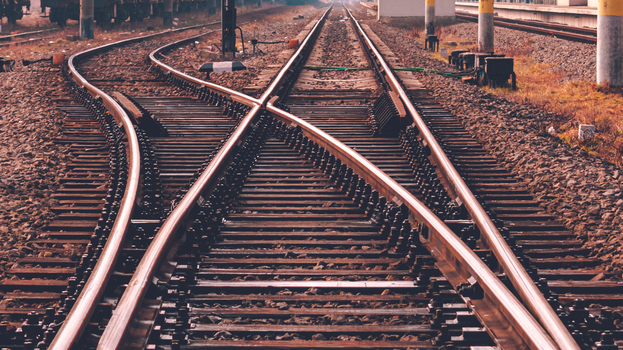
FINAL EVENT
26th of June, 2024 Civitavecchia
AGENDA
10.00 | Welcome Coffee
10.30 | PINO MUSOLINO, President of the Port Authority System
10.45 | Presentation of the project
DANIELA MANCINI, Port Authority System GIANNI MARINUCCI, Port Authority System
ANDREA PIACENTI, 3TI Progetti (Direzione Lavori)
11.00 | The role of the Port System in the TEN-T Network
MARIA GIOVANNA SGARIGLIA, Direttore Generale Ministero delle Infrastrutture e Trasporti
FEDERICA POLCE, Dirigente Divisione IV
Ministero delle Infrastrutture e Trasporti
11.15 | The European relevance of the project
TEA KRIZAN, Project Officer CINEA - Climate, Infrastructure and Environment Executive Agency
11.30 | Stakeholders consultation and Q&A
ANGELO LOJACONO , CFI -
Compagnia Ferroviaria Italiana
ENRICO LUCIANI, CILP –
Cooperativa Impresa Lavoratori Portuali
STEVEN CLERKX, CFFT -
Civitavecchia Fruit & Forest Terminal
12.30 | Closing remarks
13.00 | Light Lunch
Moderator Francesco Barontini PTSCLAS spa
Fast Track to the Sea
Implementing the upgrade of the last mile rail connections port of Civitavecchia
2019-IT-TA-0034-M

