Slide 1



Particle pollution in Italian ports & experiences from Northern European ECA
Kare Press-Kristensen
M.Sc. in engineering, Ph.D.
Senior advisor on air quality
Green Transition Denmark
kaare@rgo.dk

Slide 2

Health effects of air pollution in Italy
Around 65,000 people die from air pollution every year in Italy (EEA, 2020). That is 10.5% of all deaths (630,000).
In 2020-22 air pollution (195,000) killed more people in Italy than COVID (180,000). No vaccine against pollution.
If air pollution from shipping causes just 10% of deaths due to air pollution shipping kills 6,500 Italians per year.
Cancer, cardiovascular diseases and airway diseases etc.
It is very cost effective to reduce air pollution from ships.

Slide 3
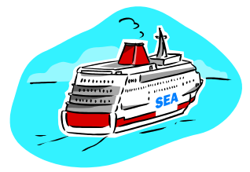

Shipping is poorly regulated
2014: All new trucks in EU have very effective exhaust gas cleaning systems – no ships have filters or catalytic converters !

Slide 4
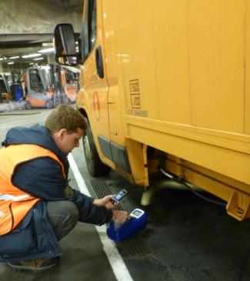
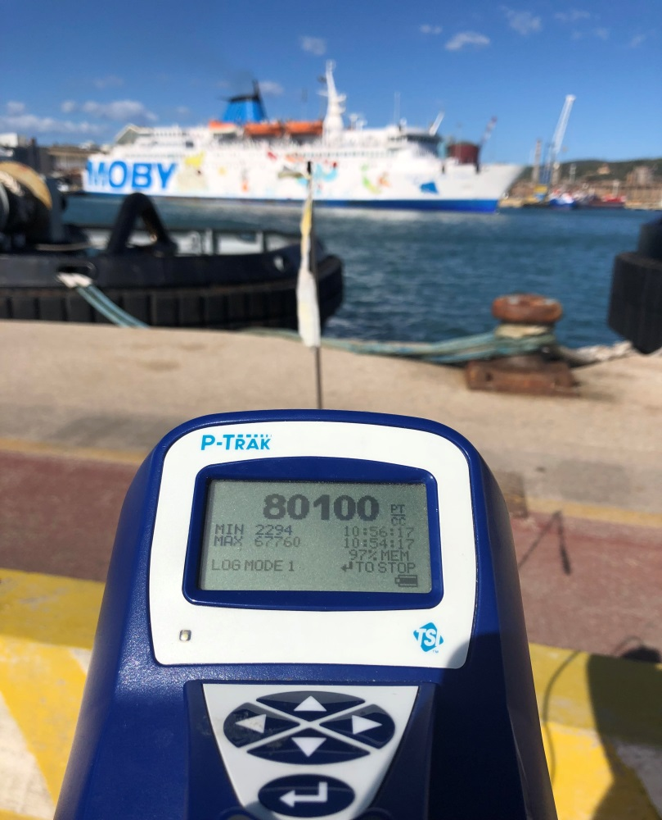
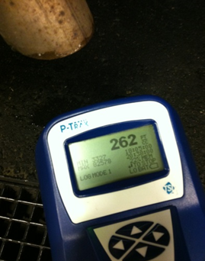
Trucks have filters – Ships have no filters
Ships have no filters. A cruise ship (4,000 p.) at berth emits as many particles as 5,500 cars per second.
Piombino
Oct. 6th, 2021
Wind: 6-8 m/s.

Slide 5
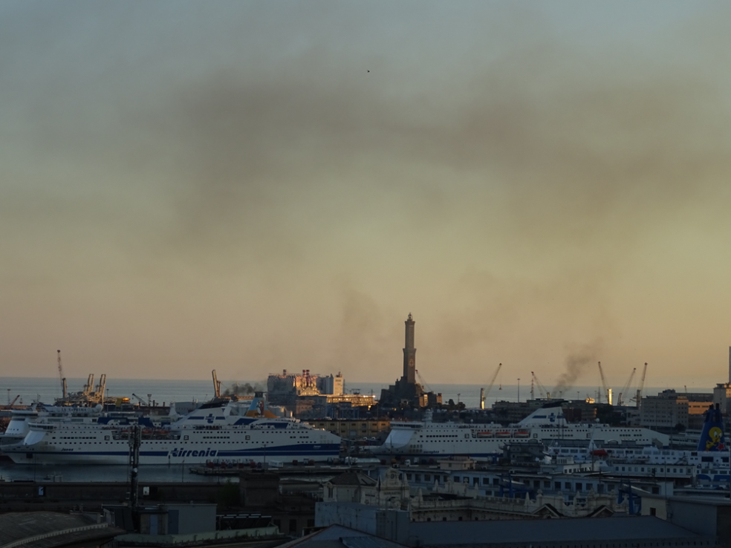
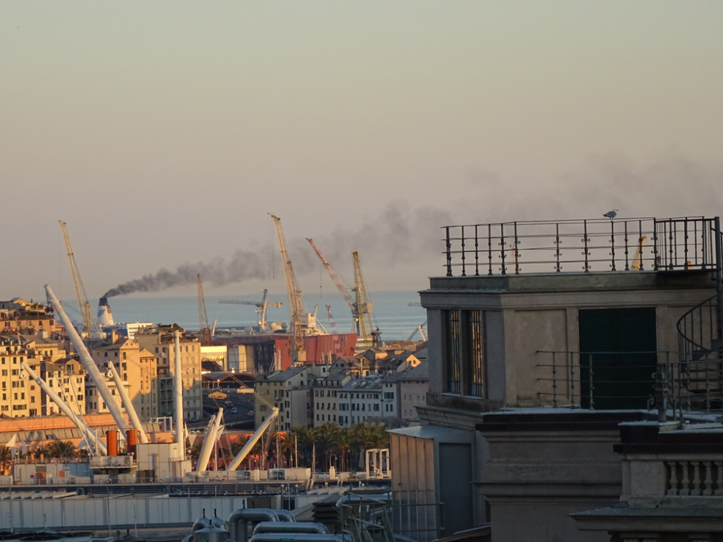
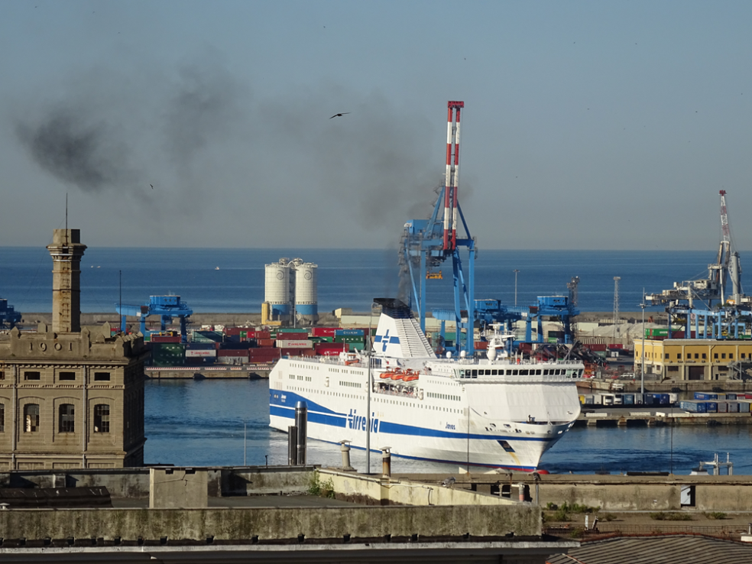
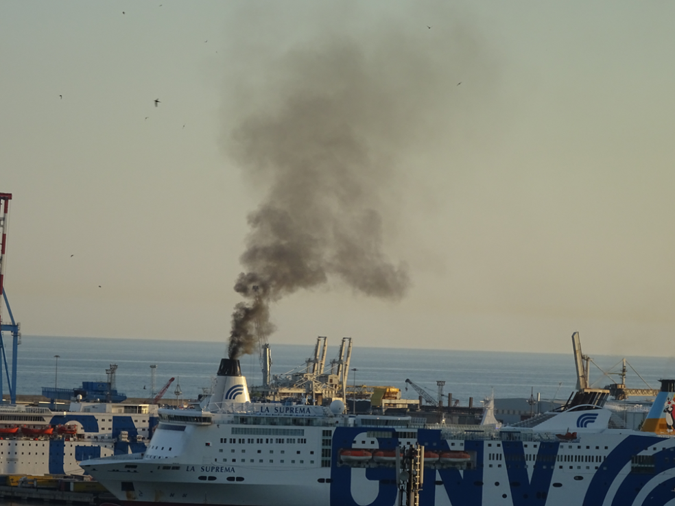
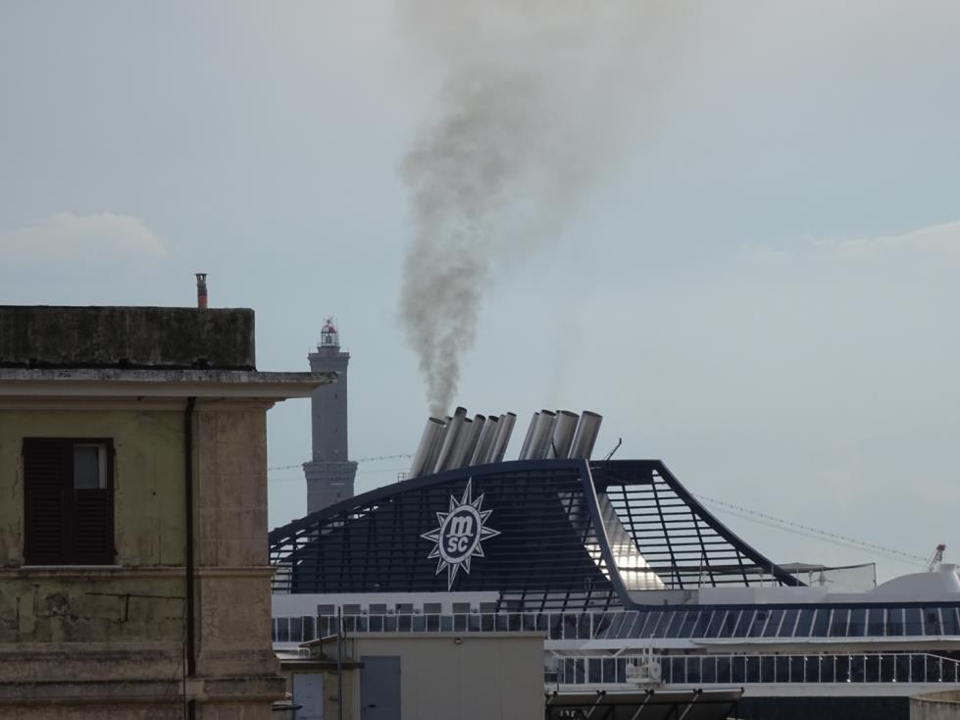
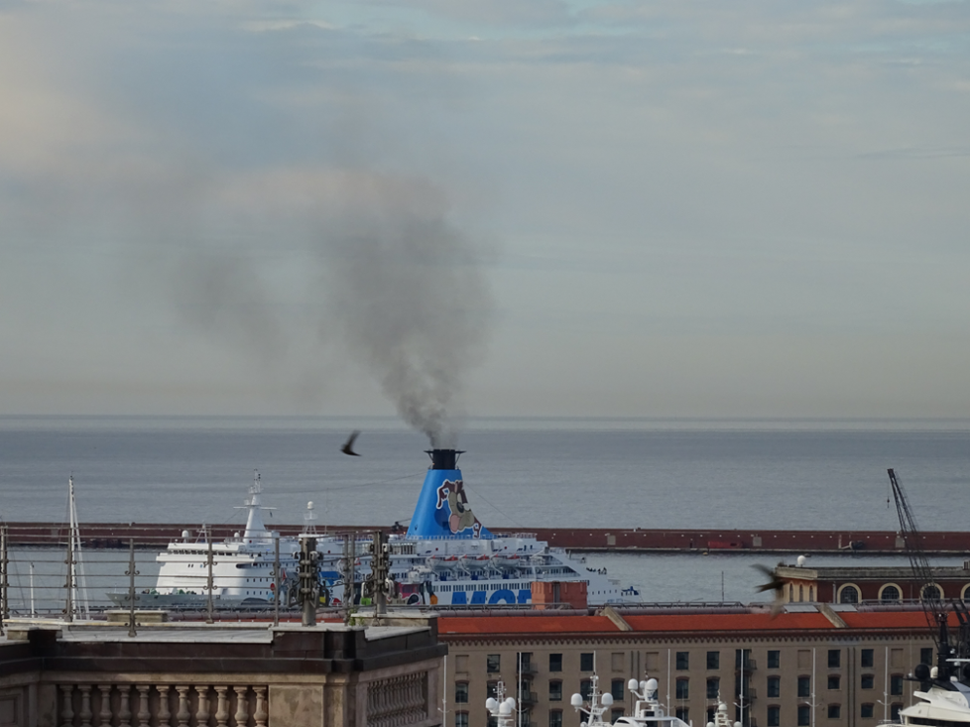
Soot from shipping (pictures from Genoa 2016)

Slide 6
Genoa: A cocktail of bad conditions
A lot of polluting ferries and cruise ships inside the heart of the city for most of the year.
The city almost covers a circle around the port so pollution plumes will hit residential areas most of the time.
City is built uphill, so chimneys are in same height as windows.
Have a warm climate so people spend much time outdoor, and windows are open when it is warm = when you have cruise ships.
Still no shore power for cruise ships and ferries.

Slide 7
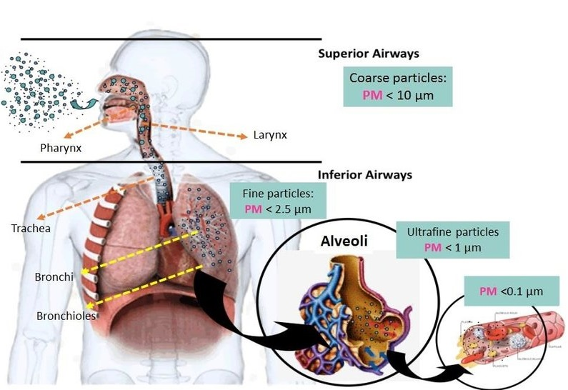
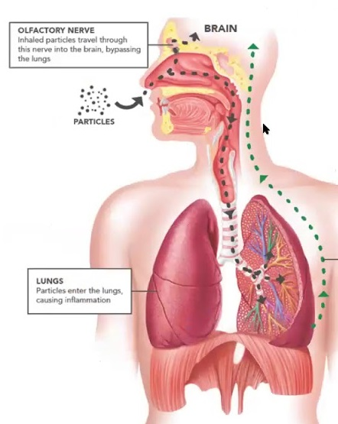
Measurements: Ultrafine exhaust particles

Slide 8
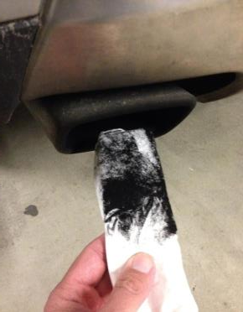
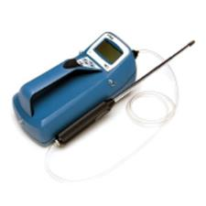
Measurements of air quality in Italy
Measured ultrafine exhaust particles.
Particles smaller than 100 nm consisting of soot (black carbon) coated with PAHs and heavy metals.
Ultrafine particles are deposited in the finest parts of the lungs (alveoli) and transferred into the blood.
Clean air in Europe contains 1,000-3,000 particles per cm³.

Slide 9


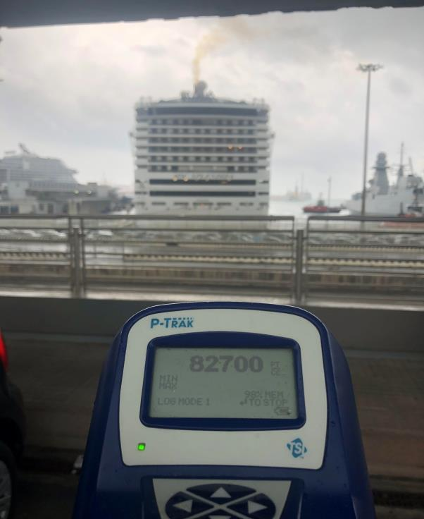
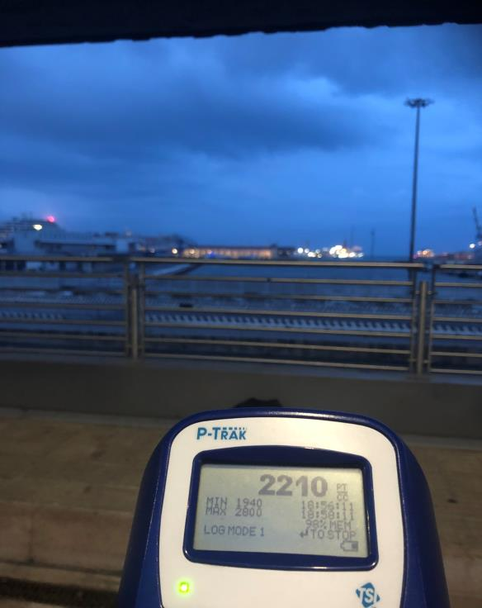
Genoa with/without cruise ship: 6-10 m/s
With cruise ship
Without cruise ship

Slide 10
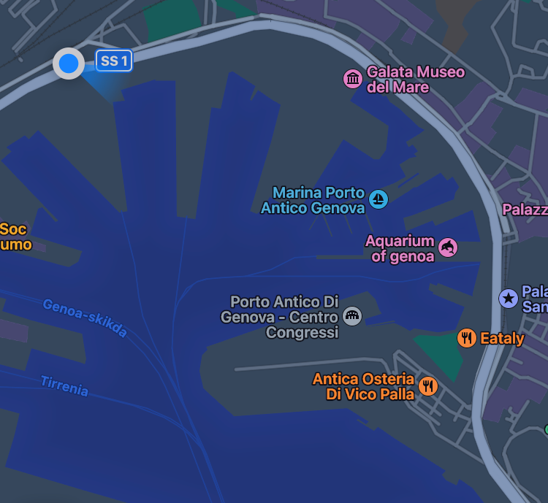
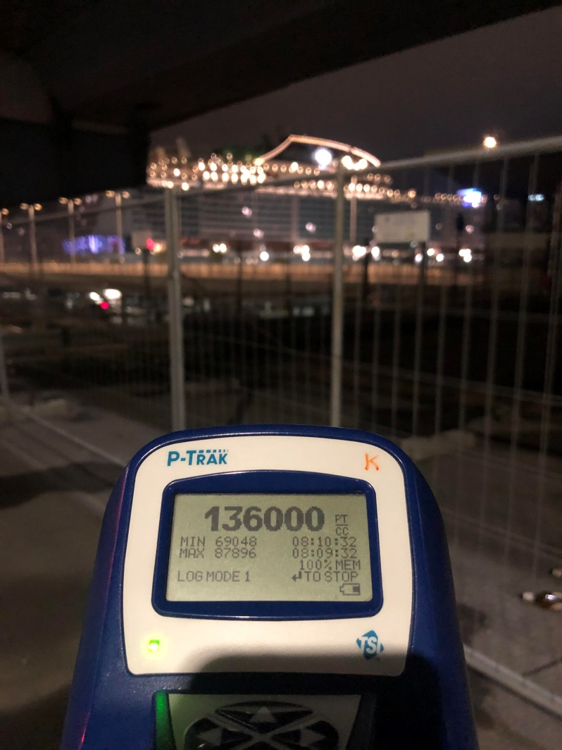
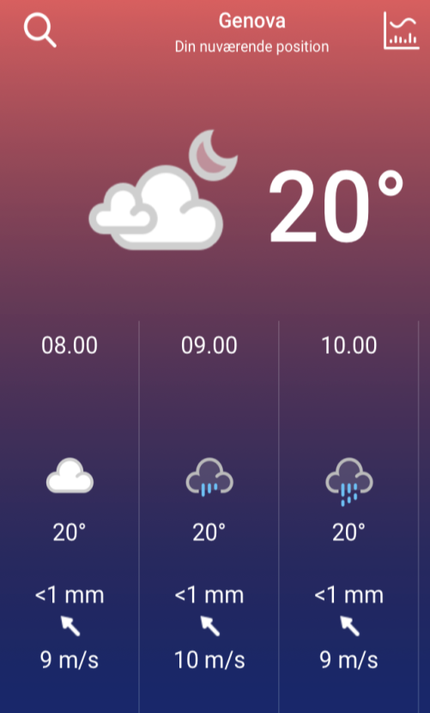
Genoa upwind cruise ship ferry: 9 m/s
Genoa, October 24, 2022

Slide 11
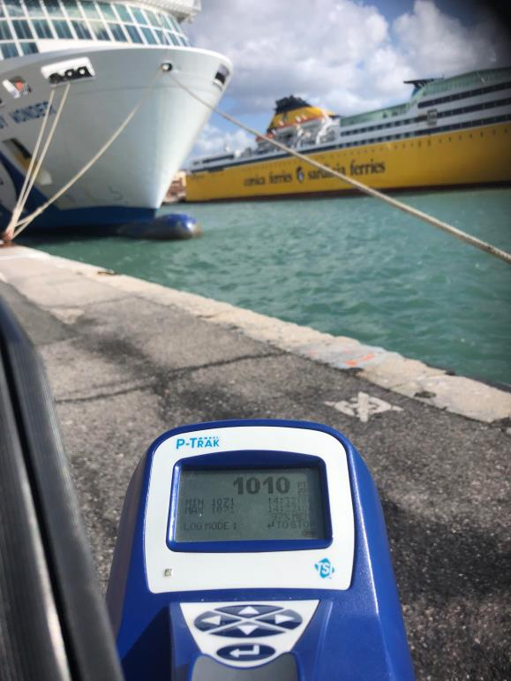
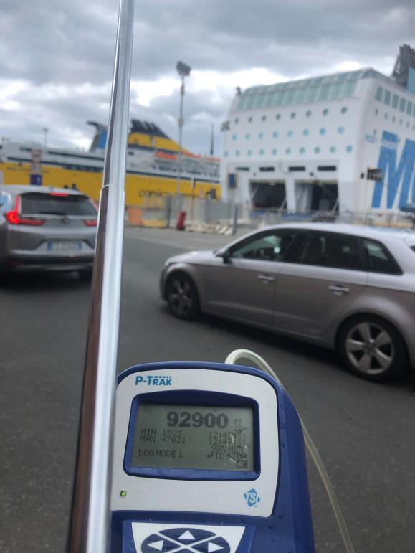
Livorno upwind and downwind ferry: 11 m/s
Up-wind: Before ship
Down-wind: After ship

Slide 12
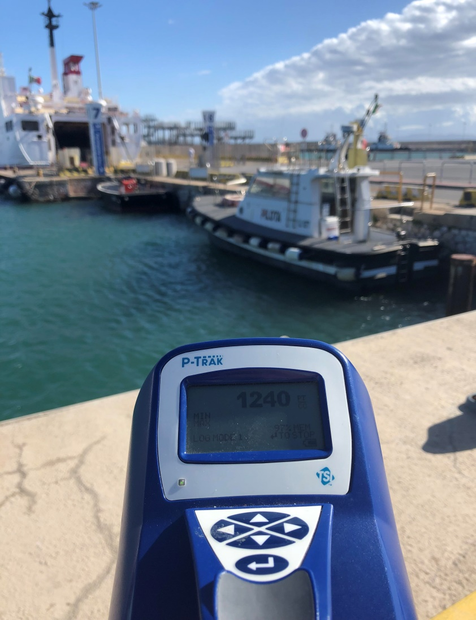
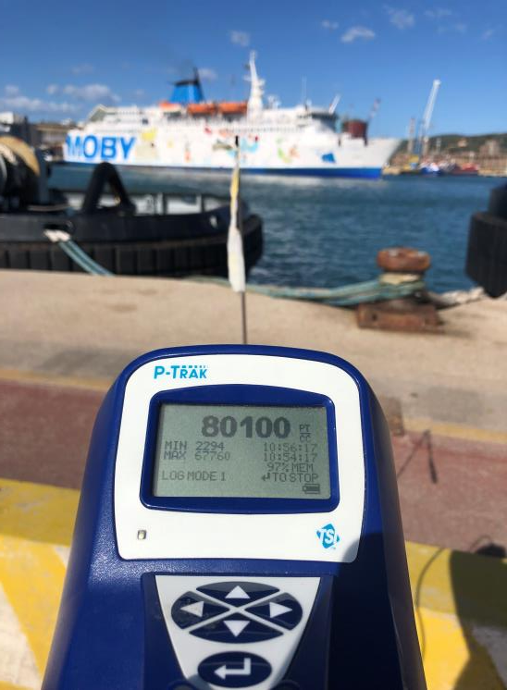
Piombino upwind/downwind ferry: 6-8 m/s
Up-wind: Before ship
Down-wind: After ship

Slide 13
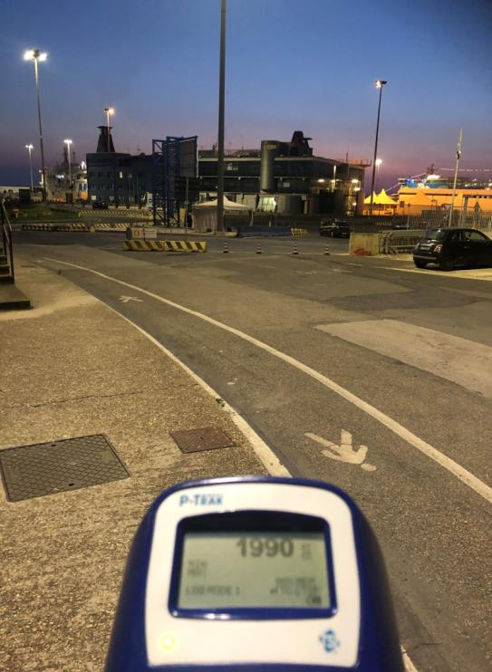
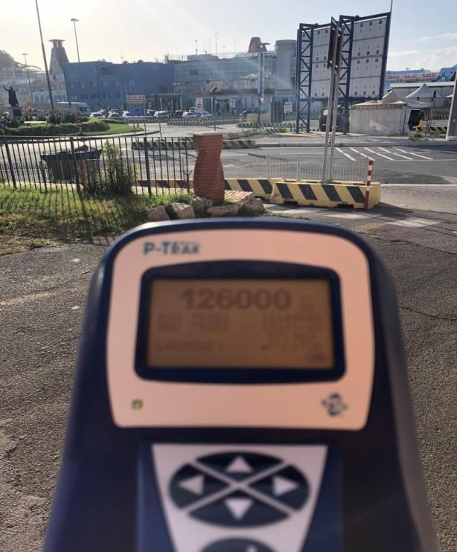
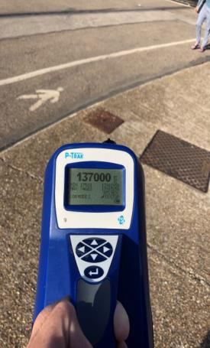
2021: Civitavecchia with/without wind from sea
No wind: Evening Oct. 1st
8 m/s from West: Oct. 6th

Slide 14
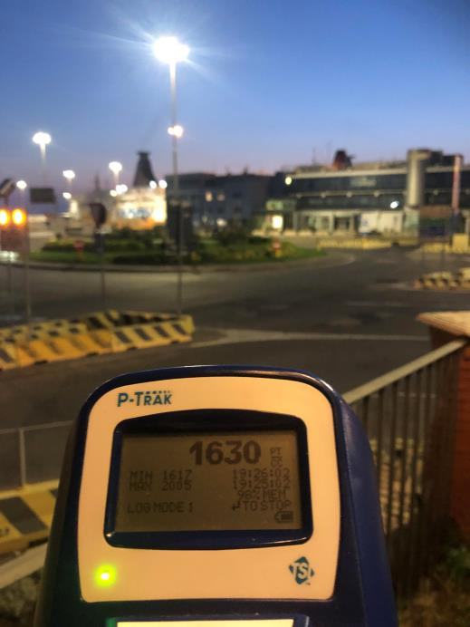
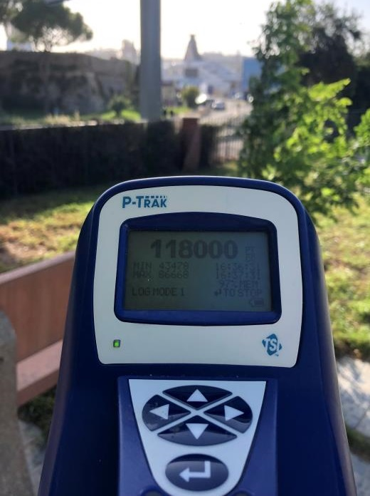
2021: Civitavecchia with/without wind from sea
No wind: Evening Oct. 1st
8 m/s from West: Oct. 6th

Slide 15
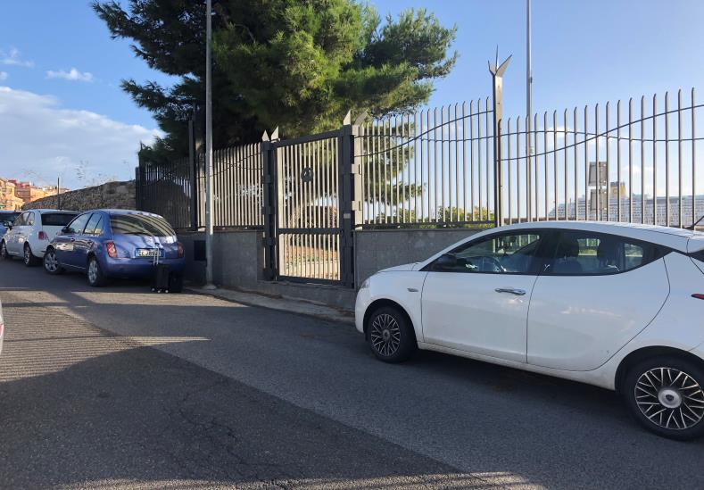
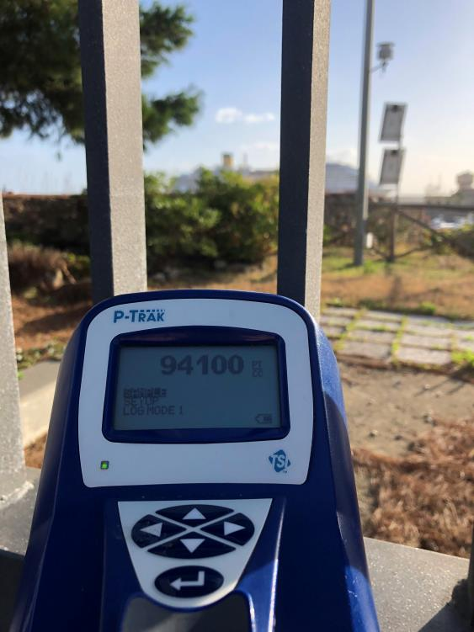
Civitavecchia: The pollution hits the city
8 m/s from West: Oct. 6th 2021

Slide 16
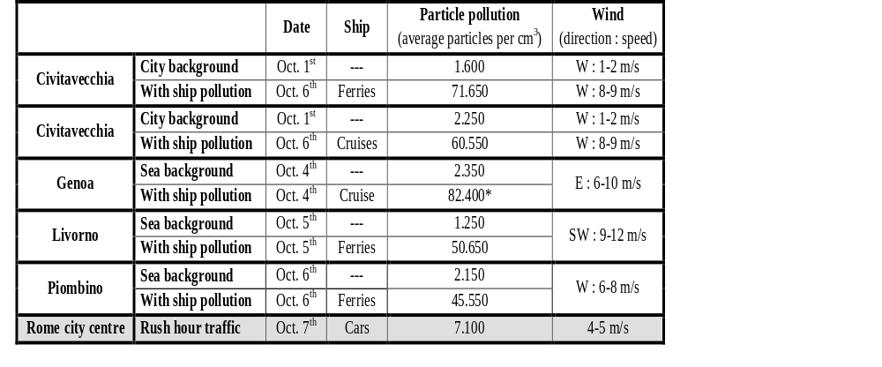
Results from measurements
Shipping cause significant pollution of Italian port cities.

Slide 17
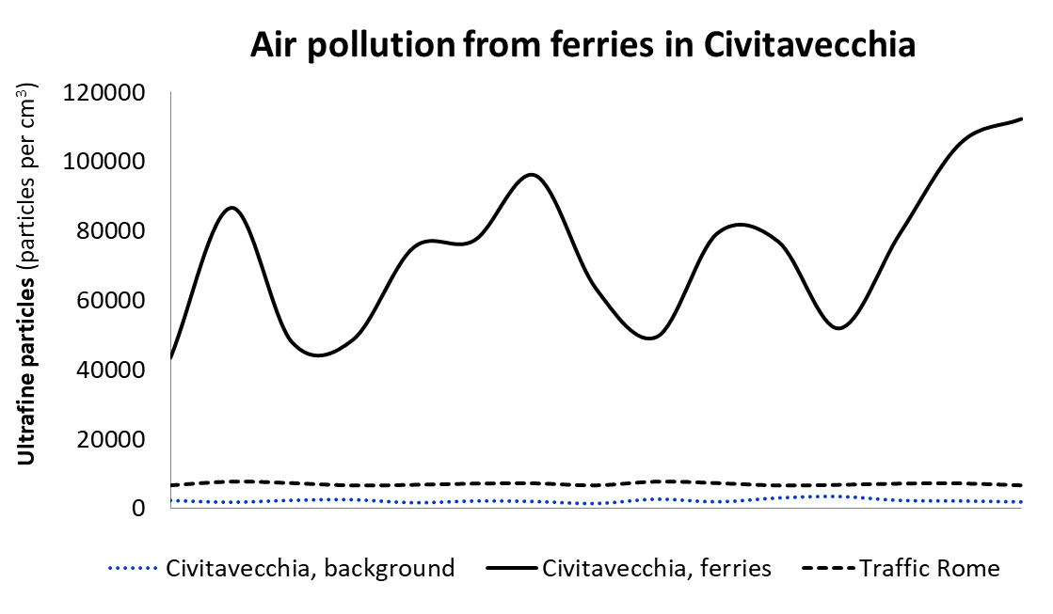
Measurements from Civitavecchia

Slide 18
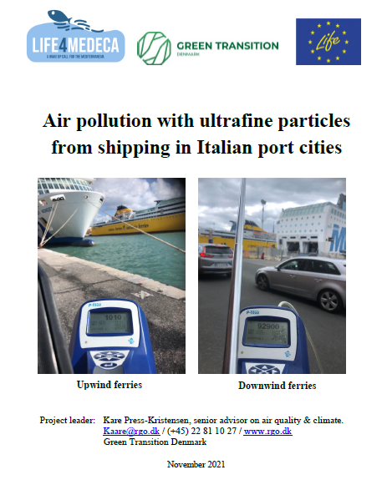
Measuring report
Report with screening measurements from Italian port cities:
https://rgo.dk/wp-content/uploads/Air-pollution-from-shipping-in-Italian-ports.pdf

Slide 19
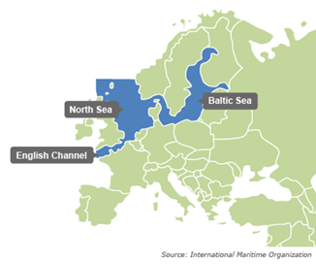
Emission control area in Northern Europe
SOx Emission Control Area from 2007 with the strictest sulphur limit from 2015.
NOx Emission Control Area from 2021 for all new build ships.

Slide 20
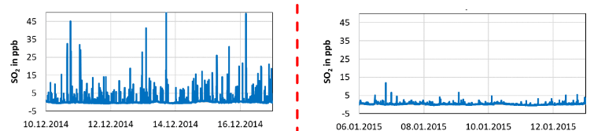
Measurements from Northern Europe
Before SECA
After SECA
Measurements from Neuwerk (German island)
Concentrations of toxic SO₂ immediately dropped, as expected, after introducing the SECA

Slide 21
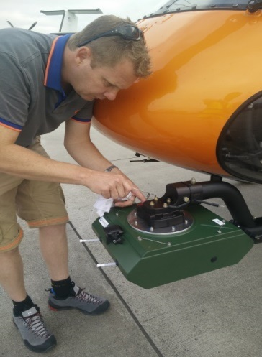
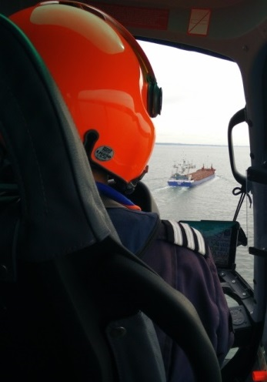
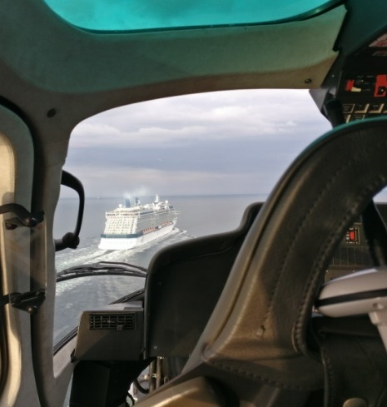
Control and enforcement
EU: - Min. 10% inspections and 4% sulphur analysis.
- Fines must prevent systematic violations.
DK: - Helicopters measuring sulphur, NOx and CO₂ directly in the ship exhaust fan at sea (600/yr.).
- Name and shame on ship/companies violating.

Slide 22
Conclusions from Northern European ECA
Plenty of distillate fuel (0.1% sulphur) available.
High reduction in sulphur on land (50% drop in 2015).
Significant health and economic benefits for society.
No enforcement challenges (0.0067% violations).
No cargo transfer from ship to road.
No notable price increases for consumers (< 0.005%).
No notable extra costs for ship owners or authorities.

Slide 23
Solutions for ship pollution
In ports:
Shore power for cruise ships, ferries, cargo ships, etc.
At sea:
Electric ferries – Great potential.
Particulate filters for ships (removes > 95%).
Emission Control Areas (ECAs) limiting emissions:
- SO₂ emissions will drop 80% immediately.
- NOx emissions will drop 80% over 20-25 years.
- Particle emissions will drop significantly and immediately.

Slide 24
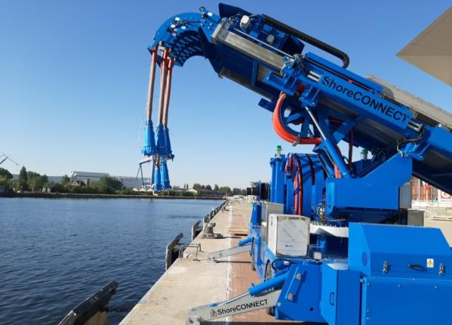
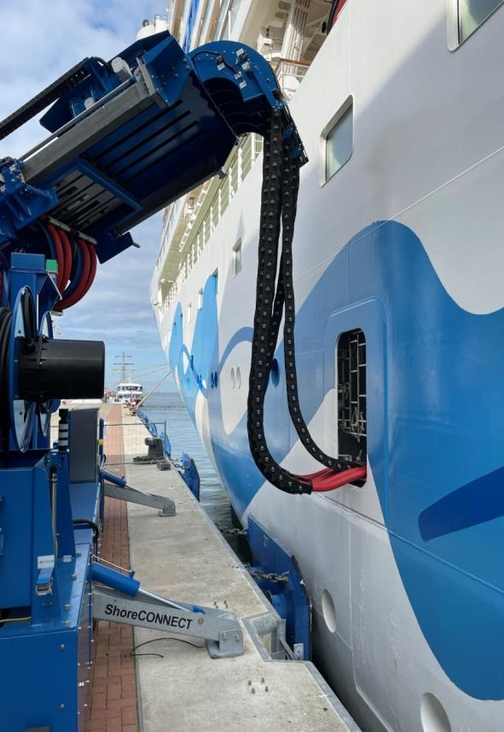
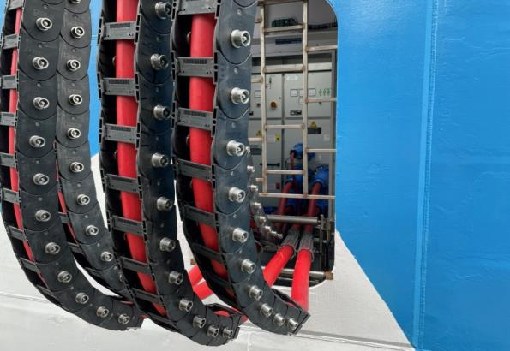
Shore power in Northern Europe

Slide 25
Electric ferries in Denmark

Slide 26
With support from EU: LIFE4MEDECA
This presentation is part of the EU LIFE project: LIFE4MEDECA with the purpose to designate a Mediterranean Sea Emission Control Area to reduce health hazardous and climate damaging emissions of air pollution from ships.

Slide 29
NOx from ships in Northern Europe
Adverse health effects: 42 € per kg NOx emission.
Removal costs: 2 € per kg NOx removed (using SCR).
Society saves around 42 billion € in health damages every time society invests 2 billion € in NOx-removal
→ Rate of return: 2.000% !
+ less damages on crops, constructions, ecosystems, etc.
A NOx ECA is the best investment you can imagine …

Slide 30
Control and enforcement
EU: - Min. 10% inspections and 4% sulphur analysis.
- Fines must prevent systematic violations.
DK: - Helicopters measuring sulphur, NOx and CO₂ directly in the ship exhaust fan at sea (600/yr.).
- Name and shame on ship/companies violating.

Slide 31
Shore power in Northern Europe

Slide 32
Electric ferries in Denmark

Slide 33
Shipping is poorly regulated
2014: All new trucks in EU have SCR & particulate filters!

